Slide 1
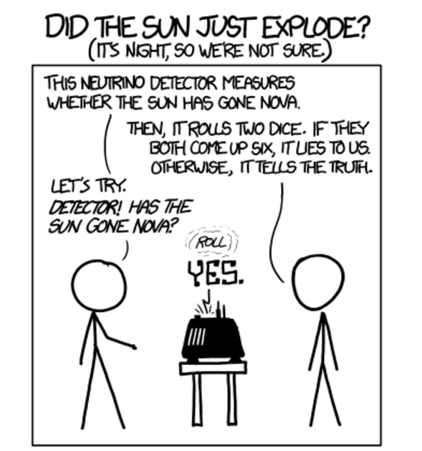
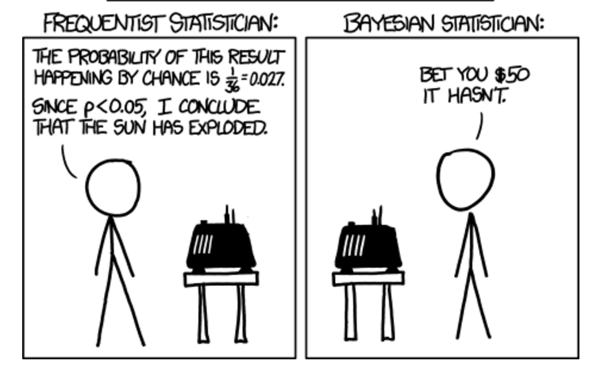
From xkcd.com

Slide 2
What is Bayesian Statistics?
Bayes Theorem in Probability is the basis for Bayesian Statistics
Bayes Theorem is named after Thomas Bayes (1701-1761)
Thomas Bayes was an English Statistician and a Presbyterian minister

Slide 3
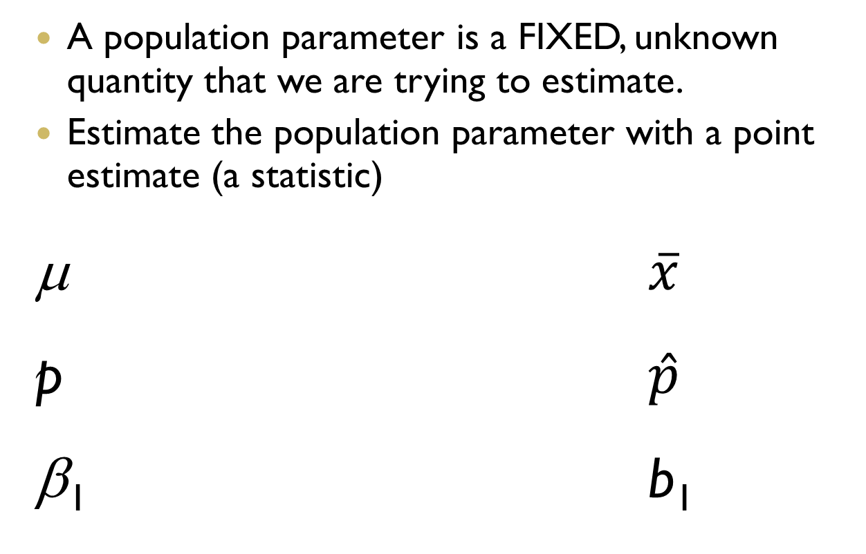
Review of Frequentist Ideology
A population parameter is a FIXED, unknown quantity that we are trying to estimate.
Estimate the population parameter with a point estimate (a statistic)
μ $\overline{x}$
p $\hat{p}$
β₁ b₁
Notes:
Use multiple points, if necessary.

Slide 4
How Bayesians view Parameters
Remember, frequentist said that population parameters are FIXED, unknown numbers (true age of Americans is one number…don’t know it, but we can get a sample to estimate it)
Bayesians believe population parameters are RANDOM VARIABLES!!
So, we are not estimating a number, we are estimating a distribution!!!! VERY different way of thinking about this!
Notes:
Use multiple points, if necessary.

Slide 5
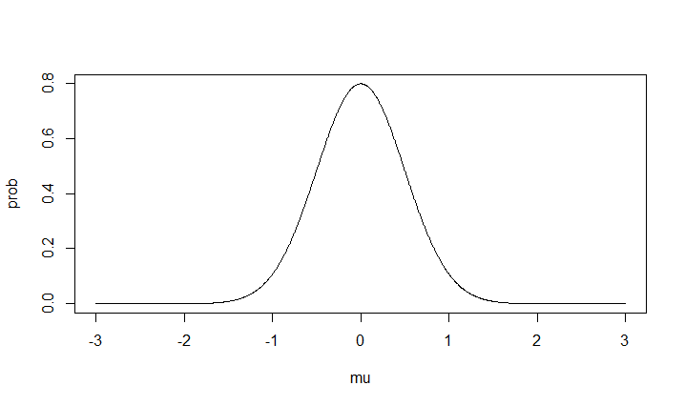
Frequentist versus Bayesian
μ
μ
Frequentist
Bayesian

Slide 6

Frequentist versus Bayesian
In both situations, we are using samples to obtain information about the population parameter
$$\overline{x}$$
Posterior distribution
μ
μ
Frequentist
Bayesian

Slide 7
The Basics (terminology)
We need to assign a prior distribution to the parameter (can be an informative prior or noninformative or vague prior)
Let’s say we looking at the mean age of Americans (μ)
The prior distribution will be denoted by p(μ)
We then collect data (p(Y|μ))and use this data to “update” this distribution to the posterior (p(μ|Y))
Notes:
Use brief bullets and discuss details verbally.

Slide 8
One more time….
Prior
p(μ)
Combined with data
p(Y|μ)
Gives posterior
p(μ|Y)
This is the goal

Slide 9
The process
First, look at the data being collected and decide what distribution the data will follow….this is very important because it defines the whole problem moving forward
Say for example your data follows the Normal distribution…what parameters are needed?
Now we need to assume distributions for these parameters
Notes:
Use brief bullets and discuss details verbally.

Slide 10
Most common data distributions:
Normal: continuous data that can take on negative and positive values
Gamma: continuous data that can only be positive (χ² is a special case of this)
Poisson: count data
Binomial: counting # success (number of females in a group)

Slide 11
Common priors:
μ: Gamma (when μ is positive)
μ: Normal (when μ can be positive or negative)
σ²: Gamma or Inverse-Gamma or Uniform
α,β: Gamma or Inverse Gamma or Uniform
p: uniform(0,1) or Beta
You will need hyperparameters for each of these distributions. You can choose them so that these distributions are very spread out (N(0,10⁶))

Slide 12
Let’s try it:
Want to estimate proportion of college athletes with hip replacements
Want to estimate number of car accidents at an intersection
Want to estimate volatility of a stock

Slide 13
Posterior distribution
Now we have prior, we’ve collected the data, we are ready to put them together to get the posterior
Posterior distribution can be simulated via Markov Chain Monte Carlo (MCMC) techniques

Slide 14
MCMC
Posterior distribution is complex, so we choose a possible value for the parameter:
?

Slide 15
MCMC
Posterior distribution is complex, so we choose a possible value for the parameter:

Slide 16
MCMC
Posterior distribution is complex, so we choose a possible value for the parameter:

Slide 17
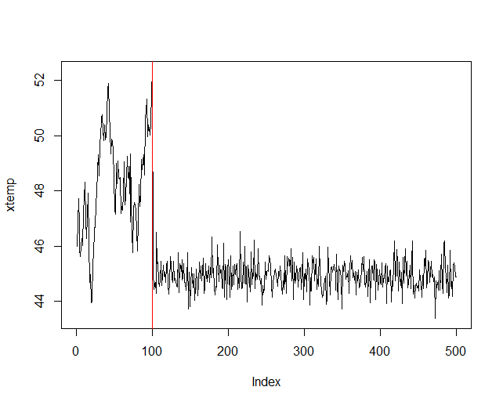
Chain finally settles down to the posterior distribution

Slide 18
Chain finally settles down to the posterior distribution
Burnin
Posterior samples

Slide 19
Need to download Rstan (there is also a Python version of Stan)
Go to https://github.com/stan-dev/rstan/wiki/RStan-Getting-Started
And follow the directions.

Slide 20
Basic Rstan code;
data=list()
stan(file, chains = 4, iter = 5000, warmup = 1000, data=data.info)

Slide 21
Now let’s get started….

